Slide 1
Endoscopic Capsule for Cancer Cells Detection using CMOS optical sensors
Guided by:
Mrs.Mangala Kini
By:
Arpitha S
Ashritha Jain R

Slide 2
Contents
1.Introduction
2.Cancer cells and detection
3.Autofluorescence
4.CMOS optical sensor design
5.CMOS optical sensor fabrication
6.Experimental results
7.Conclusion
8.References

Slide 3
1.INTRODUCTION
Gastrointestinal cancer(GI) are among fifth most common cancers worldwide.
Endoscopic techniques: The most common methods for the gastrointestinal (GI) tract evaluation in medicine .
Endoscopic techniques allow visual access to different parts of the GI tract such as esophagus, stomach and intestine.
OGIB: Some parts of the small intestine remain inaccessible and a complete and efficient diagnosis cannot be performed.

Slide 4
Contd…
Endoscopic capsule(EC) - To overcome OGIB
EC - It is a pill-sized wireless swallow able camera that travels through the GI tract taking pictures.
EC comprises two batteries and an antenna through which it sends the obtained images to several sensors placed on the patient's abdomen .
The sensors are connected to a data recorder that is fixed to a belt carried by the patient.
At the end of the examination the data are downloaded to a workstation to produce a video.

Slide 5
Contd…
The image is obtained with a 1400 field of view, 1:8 magnification, 1-30 mm depth of view and a minimum pixel-size of about 0.1 mm.
Advantages:
1.The patient can perform his normal daily activities.
2.Capsules are disposable, there’s no risk of infection.
An EC equipped with these improvements may avoid the traditional surgical biopsy used for removing the tumor cells.
Presently, some of the most promising methods for detecting cancer at an early stage are based on tissue's fluorescence.

Slide 6
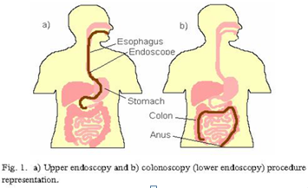
Contd…

Slide 7
2.CANCER CELLS AND DETECTION
A .Cells and Cancer
The organs of the digestive system are covered by epithelial tissue which includes the squamous cells and the adenomatous cells.
Once these cells are at tissue surface, they are suitable for analysis by sensors or even biosensors incorporated in the EC.
The spectral response of adenomatous cells in epithelial tissue in presence and absence of adenocarcinoma is studied for proper design of CMOS optical sensors.

Slide 8
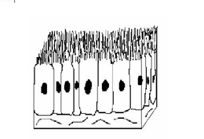
Contd…
Fig . Adenomatous cells representation

Slide 9
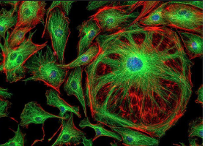
Contd…
B .Autofluorescence
Autofluorescence is the natural emission of light by biological structures.
Namely mitochondria and lysosomes when they have absorbed light, and is used to distinguish the light originating from artificially added fluorescent markers .
Fig . Fluorescent effect of cells captured using CMOS

Slide 10
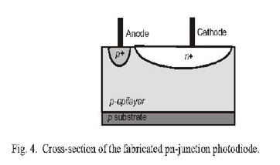
3.CMOS OPTICAL SENSOR DESIGN
The optical sensors should be incorporated in an EC for measuring the spectral auto fluorescence of epithelial tissue.
They should have integrated in the same die their readout circuits for converting the analog photodetectors signal into a digital signal.
The economic viability of that detection system critically depends on the possibility of realizing the system in a standard microelectronic process.

Slide 11
Contd…
The CMOS optical sensors design involves selection of the photo detector type .
A deeper junction shows in general an enhanced long wavelength response.
Selecting the suitable junction depth allows to set a maximum peak at a specific wavelength.
Along with the depth , spectral response is determined by thickness and material properties of the dielectric layers.
Layer arrangement forms an interference filter with the interference peak at different wavelength.

Slide 12
Contd…
The photodetectors are pn-junction photodiodes, fabricated using the n+/p- epilayer junction.
The structure is chosen because it provides the best possible quantum efficiency in the desired spectral range, due to the different doping concentration between the n and the p side.
It increases depletion area more deeply at p side.
In addition to convert analog to digital signals Sigma- Delto converters are used.

Slide 13
Contd…
This converter produces a bit stream signal and allows its use in small data-acquisition and control systems.
The sigma-delta output signal is proportional to the photodiode current and hence proportional to the fluorescent light emitted by the tissue.
Small number of transistors, occupying a very small area in the device, which enables the introduction of several photodetectors .

Slide 14
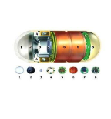
Contd…
PARTS OF THE PRODUCT
Optical dome
Lens holder
Lens
Illuminating LED’’s
CMOS image sensor
Battery
ASIC transmitter
Antennae

Slide 15
Contd…
1.OPTICAL DOME
The optical Dome contains the light receiving window. The window along
With container are sealed to prevent infiltration of digestive fluids inside the capsule.
2. LENS HOLDER
The lens holder is that part of the capsule which accommodates the lens.
3. LENS
The lens is that part of the pill camera arranged behind the Light Receving window.

Slide 16
Contd…
4. ILLUMINATING LED
Around the Lens & CMOS Sensor, four LEDs are present. These plural lighting devices are arranged in donut shape.
5. CMOS IMAGE SENSOR
CMOS produces very high quality images.
6. BATTERY
Silver oxide primary batteries are used. Such a battery has a even discharge voltage, disposable.

Slide 17
Contd…
7. ASIC TRANSMITTER
Two transmitting electrodes are connected to the outlines of ASIC Transmitter.
8. ANTENNA
The dome containing the antenna is made of no conducting material which is harmless to the human body. Parylene coated on to poly ethylene or polypropylene is used.

Slide 18
Contd…
HOW IT WORKS INSIDE THE BODY
Down the Hatch
Power Up
Start Snapping
Spin For Close-Ups

Slide 19
5. CMOS OPTICAL SENSOR FABRICATION
The CMOS compatible photodetectors and readout circuits have been fabricated through a double-metal, single polysilicon, 0.7 ptm n-well CMOS process.
It is restricted to combinations of the three dielectric layers available on top the pn -junction.
An oxide layer, with a thickness around 600 nm, can increase the transmittance from 50% to 60%, but also introduces wavelength dependence.

Slide 20
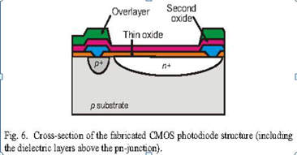
Contd…

Slide 21
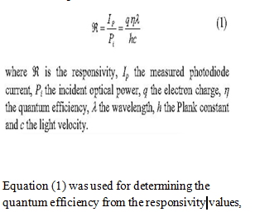
6. EXPERIMENTAL RESULTS
The spectral response and the quantum efficiency curves of the fabricated photodiodes, measured using the calibrated Hamamatsu photodiode as reference.

Slide 22
7. CONCLUSION
The on-chip integrated CMOS optical sensors presented here have been developed for being integrated in an endoscopic capsule for measuring the emission spectrum of normal and cancer cells.

Slide 23
8. REFERENCES
[1] D. Fleisher, "Capsule imaging", Clinical Gastrology and Hepatology, vol. 3, pp. s30-s32, July 2005.
[2] R.S. DaCosta, B.C. Wilson, and N.E. Marcon, "Spectroscopy and fluorescence in esophageal diseases," Best Practice & Research Clinical Gastroenterology, vol. 20, pp. 41-57, February 2006.

Slide 24
THANK YOU

